Slide 2
Differences in snRNaseq vs. Spatial
Some populations are much more clear on Spatial
  DTL
Some populations are much more clear on single-nucleus
P

Slide 3
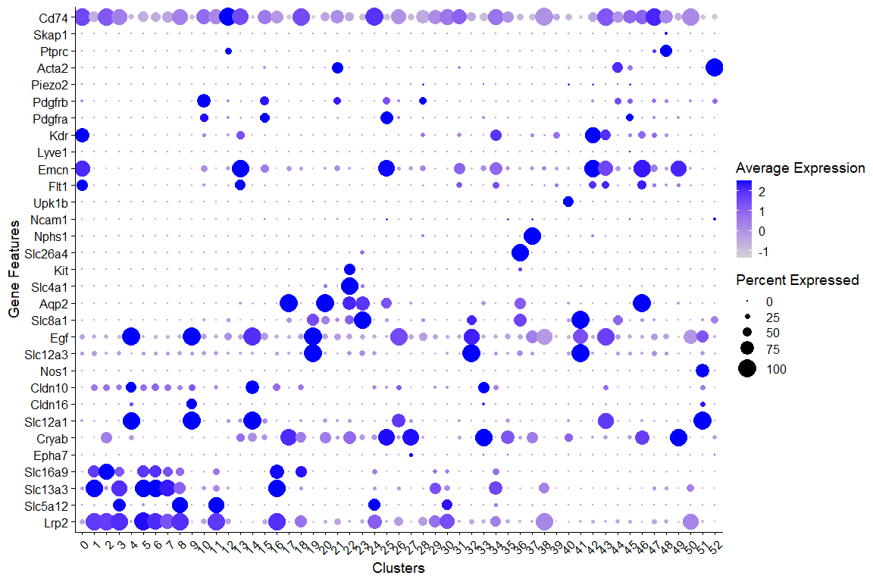

Slide 4
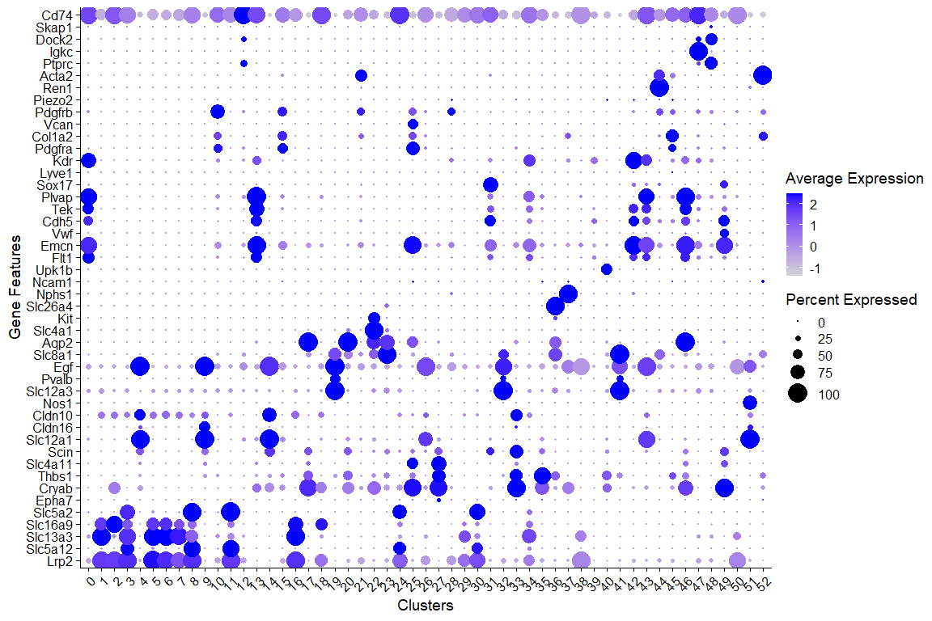

Slide 5
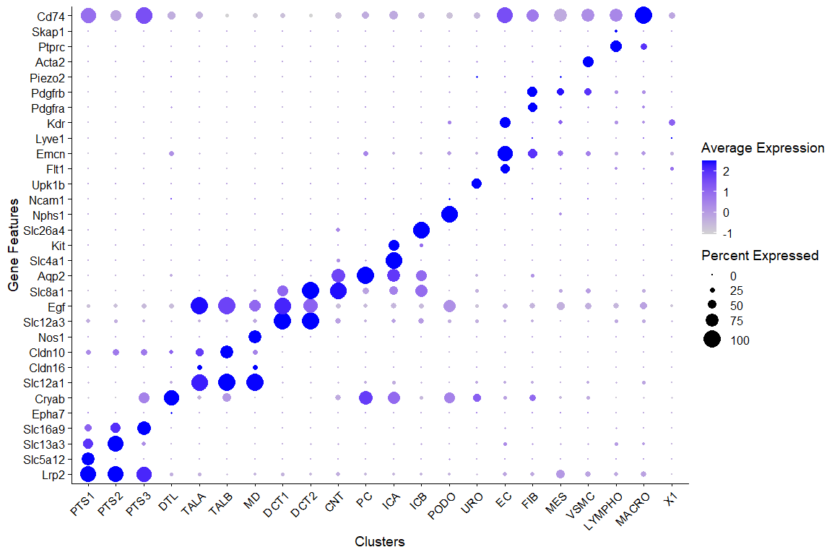
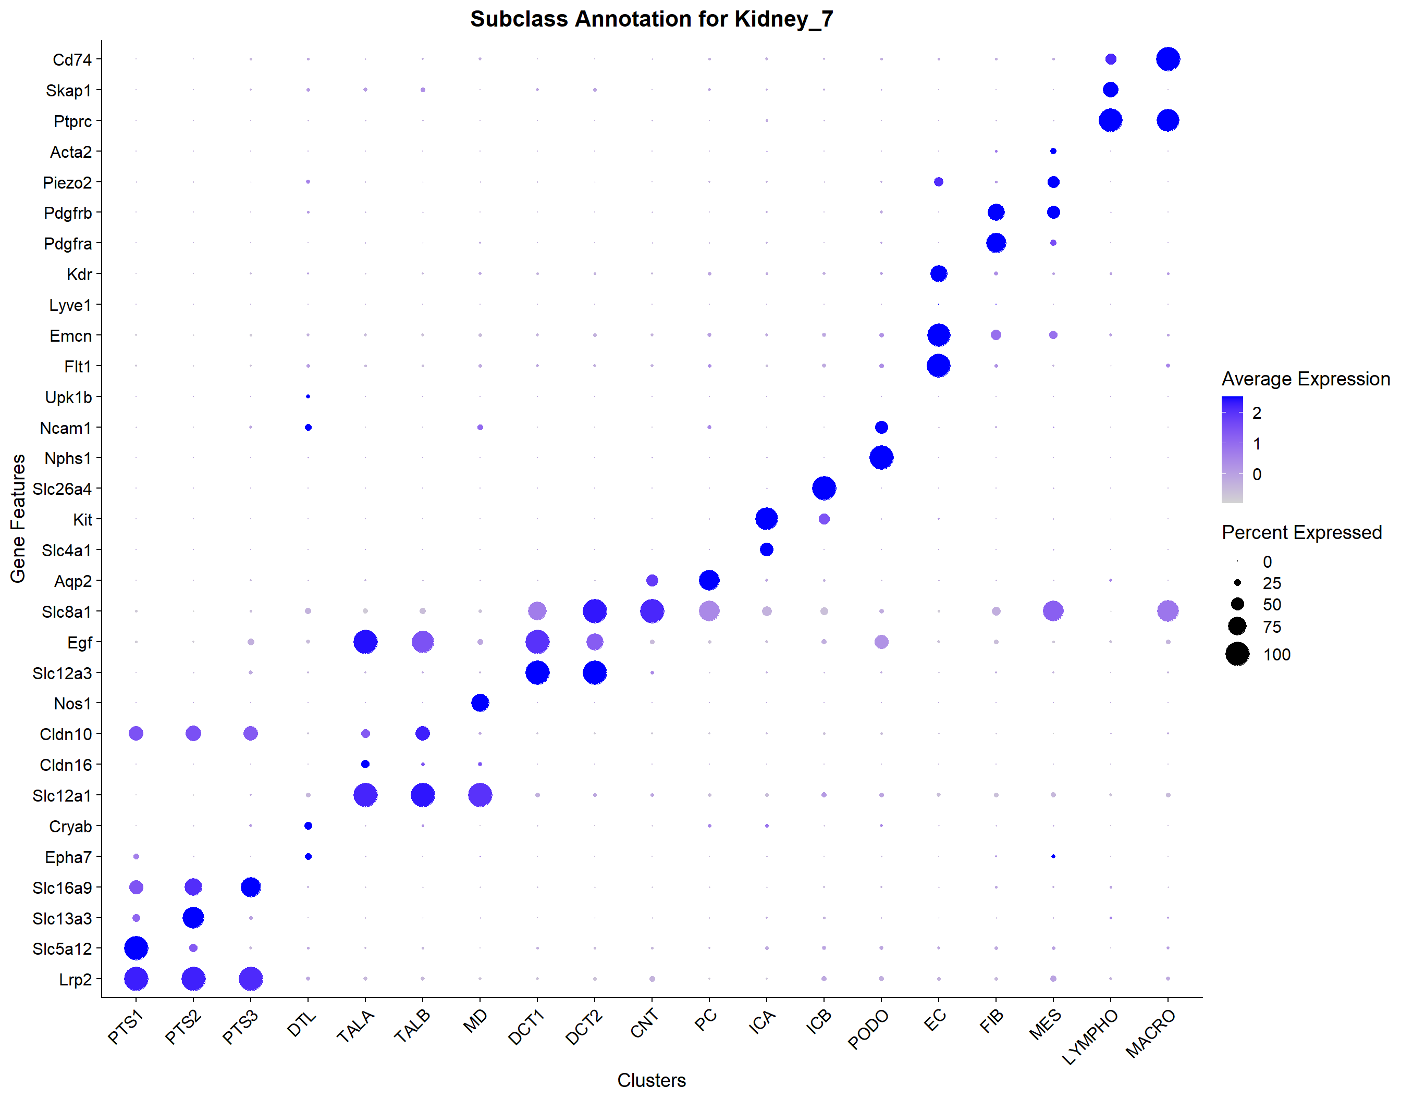
Xenium Annotation
snRNAseq Annotation

Slide 6
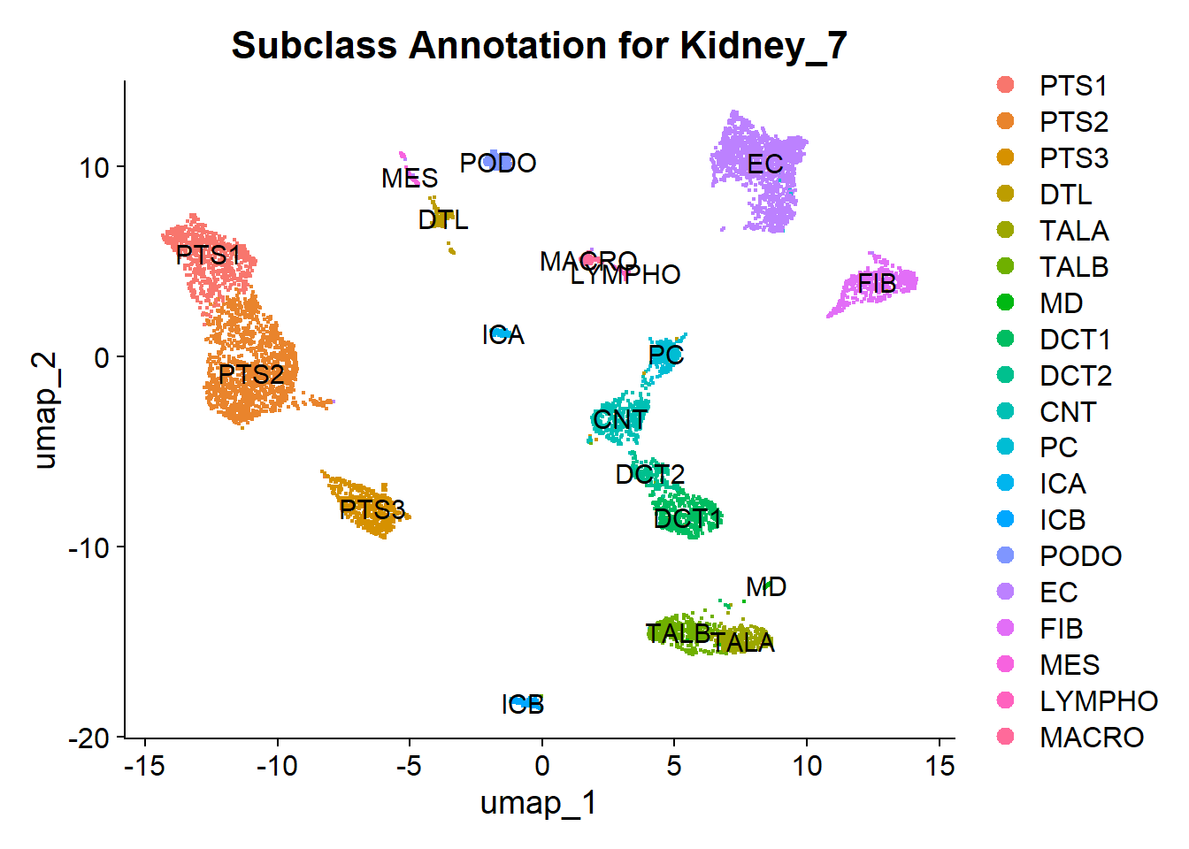
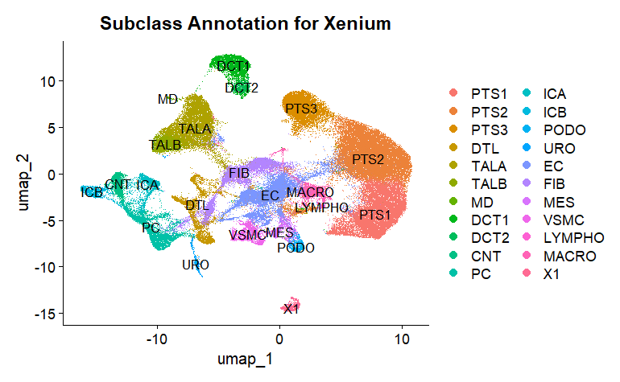
Xenium Annotation
snRNAseq Annotation

Slide 7
Xenium Annotation
snRNAseq Annotation

Slide 8
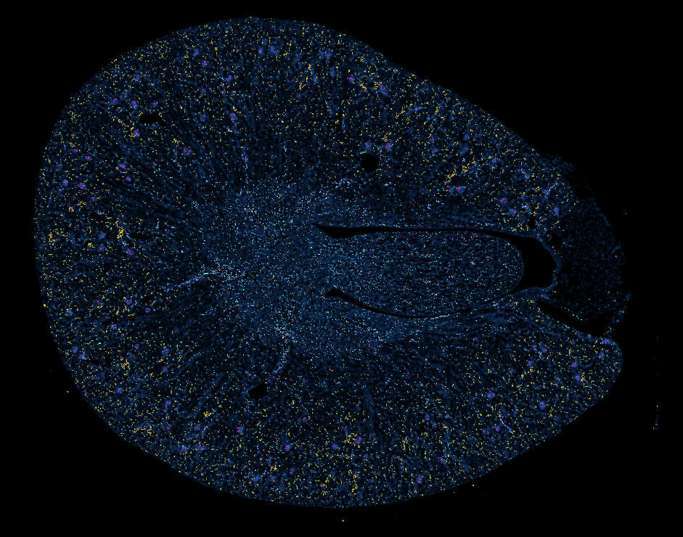

Slide 9
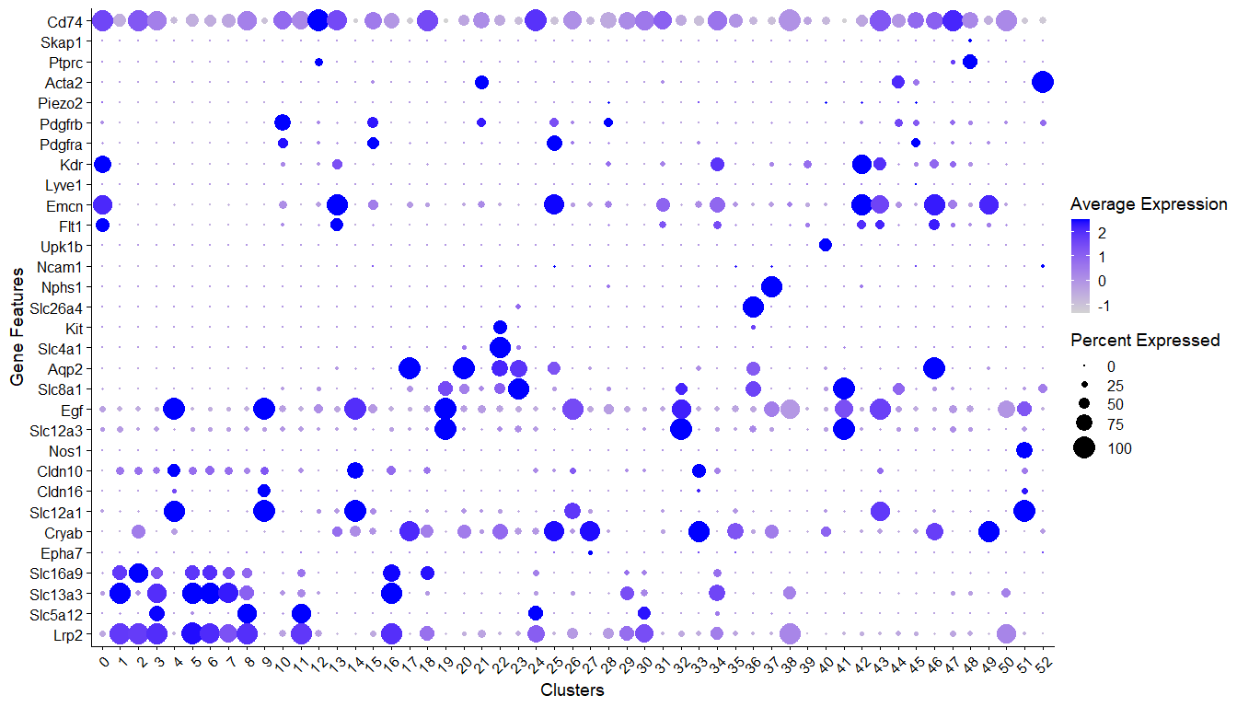
EC Clusters

Slide 10
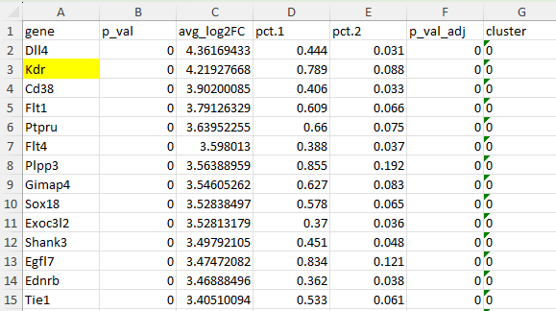
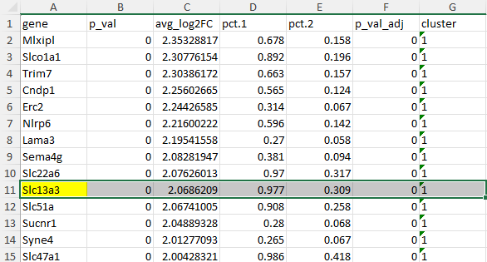
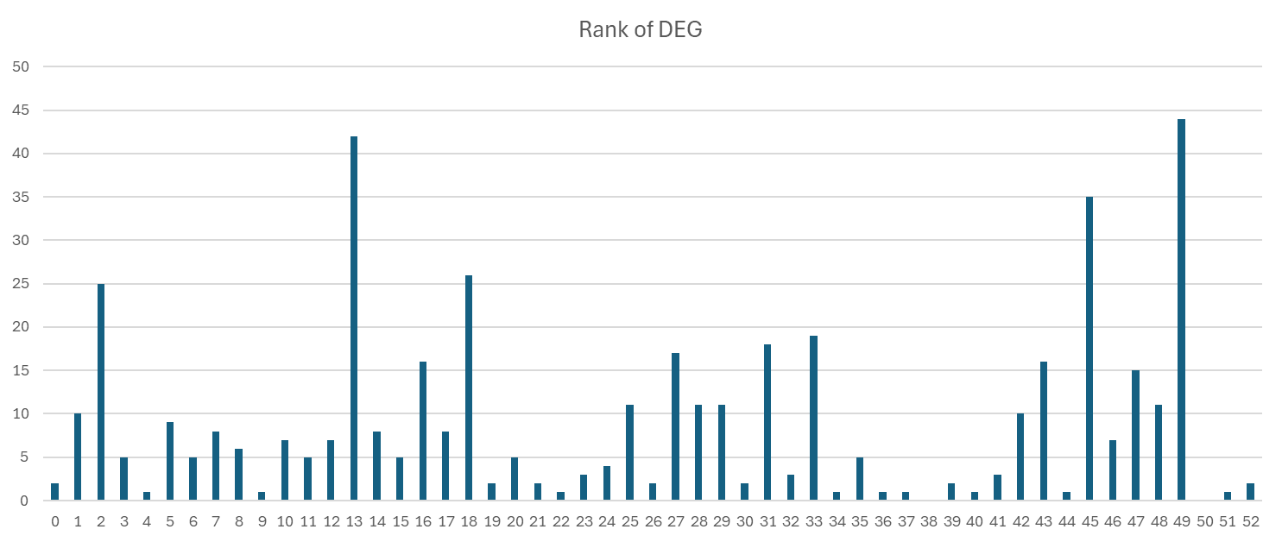
Cluster 0
Cluster 1
Rank of DEG
Cluster

